Slide 1
Naïve Bayes Classifier
Ke Chen

Slide 2
Outline
Probabilistic Classification
Naïve Bayes
  Principle and Algorithms
  Example: Play Tennis
Relevant Issues
Summary

Slide 3
Generative vs. Discriminative Classifiers
Training classifiers involves estimating f: X → Y, or P(Y|X)
Discriminative classifiers (also called ‘informative’ by Rubinstein&Hastie):
Assume some functional form for P(Y|X)
Estimate parameters of P(Y|X) directly from training data
Generative classifiers
Assume some functional form for P(X|Y), P(X)
Estimate parameters of P(X|Y), P(X) directly from training data
Use Bayes rule to calculate P(Y|X= x_{i})

Slide 4



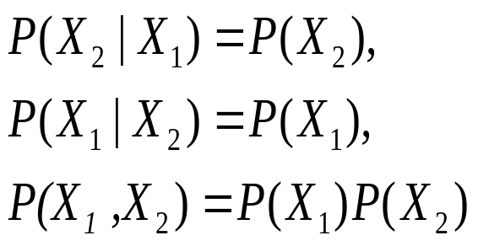
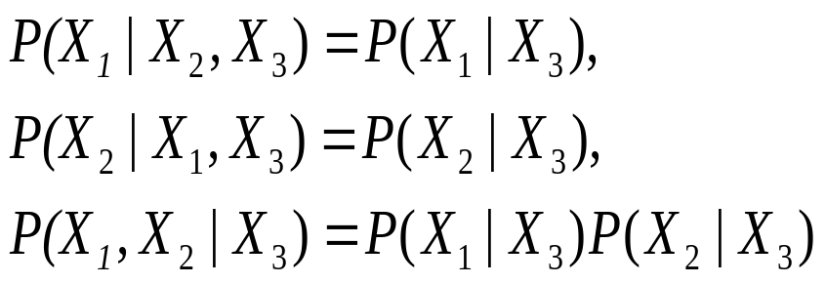
Probability Basics
Prior, conditional and joint probability for random variables
  Prior probability:
  Conditional probability:
  Joint probability:
  Relationship:
  Marginal Independence:
  Conditional Independence:
Jika X₁ dan X₂ saling conditionally
independent given X₃

Slide 5
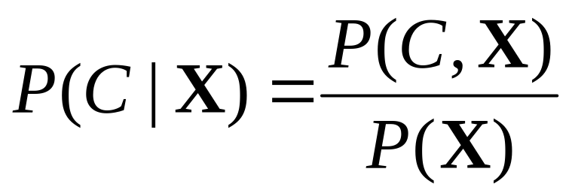
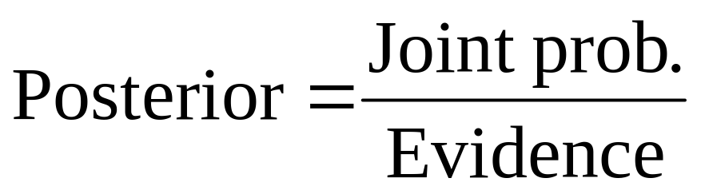
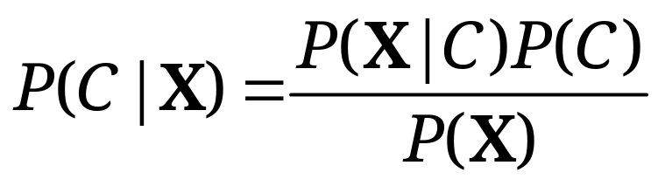
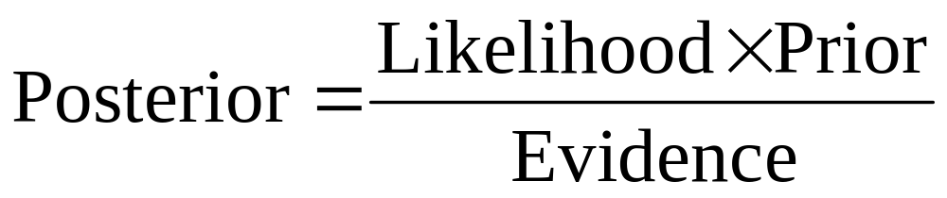
Bayesian Rule
1.
2.

Slide 6
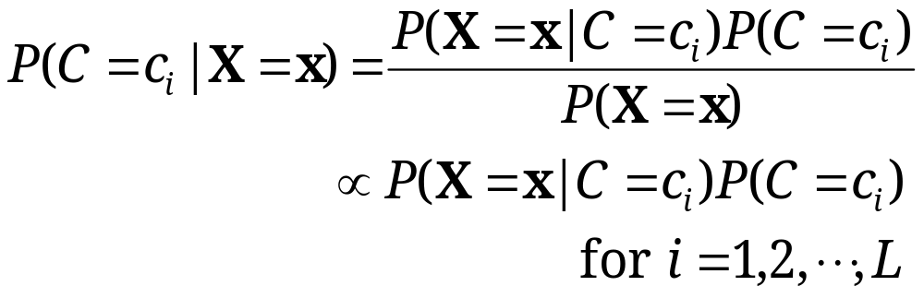
Probabilistic Classification
MAP classification rule
  MAP: Maximum A Posterior
  Assign x to c* if
Generative classification with the MAP rule
  Apply Bayesian rule to convert them into posterior probabilities
  Then apply the MAP rule

Slide 7

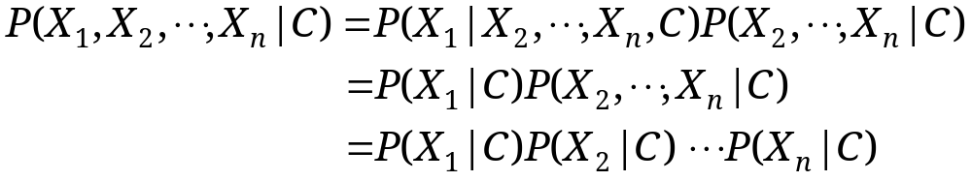
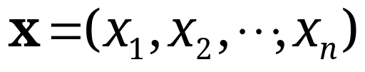
Naïve Bayes
Bayes classification
  Difficulty: learning the joint probability
Naïve Bayes classification
  Assumption that all input features are conditionally independent!
  MAP classification rule: for
Notes:
For a class, the previous generative model can be decomposed by n generative models of a single input.

Slide 8
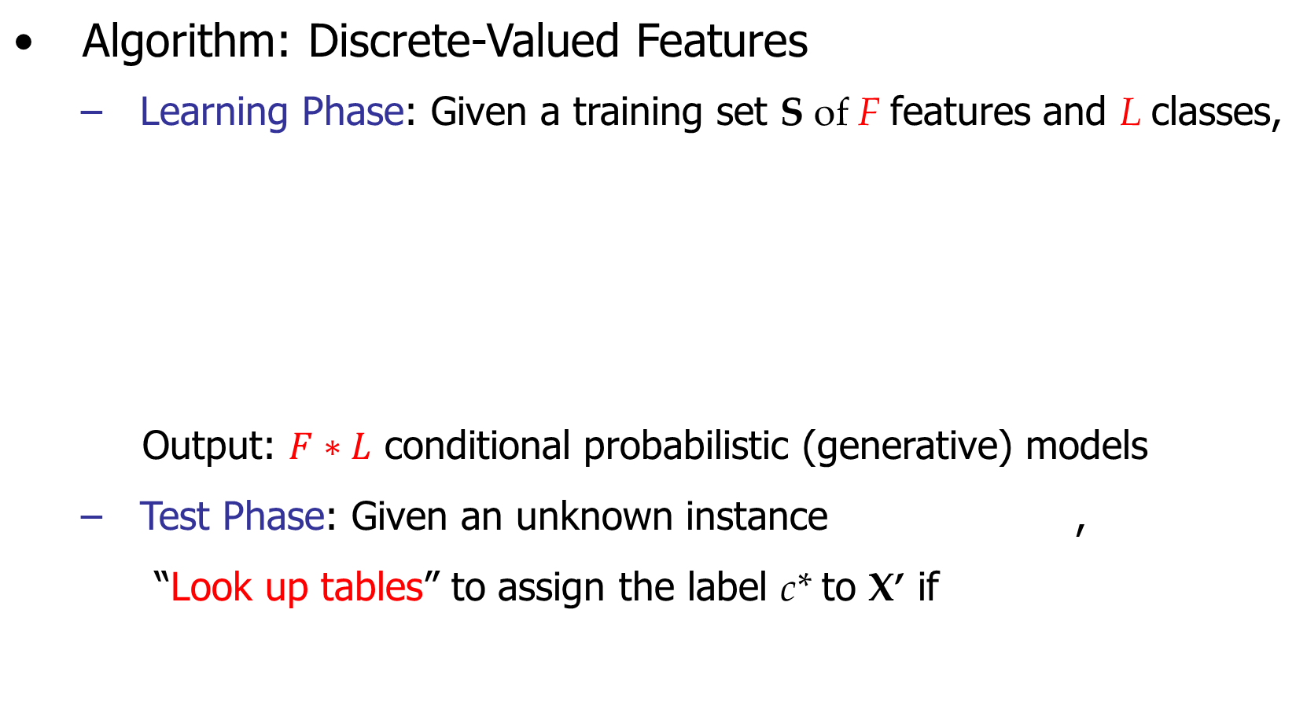
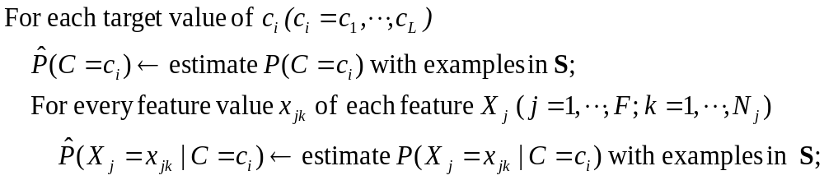

Naïve Bayes

Slide 9

Example
Example: Play Tennis
Mild
Mild

Slide 10
Example
Learning Phase
Outlook | Play=Yes | Play=No
Sunny | 2/9 | 3/5
Overcast | 4/9 | 0/5
Rain | 3/9 | 2/5
Temperature | Play=Yes | Play=No
Hot | 0/9 | 2/5
Mild | 6/9 | 2/5
Cool | 3/9 | 1/5
Humidity | Play=Yes | Play=No
High | 3/9 | 4/5
Normal | 6/9 | 1/5
Wind | Play=Yes | Play=No
Strong | 3/9 | 3/5
Weak | 6/9 | 2/5
P(Play=Yes) = 9/14
P(Play=No) = 5/14

Slide 11
Example
Test Phase
  Given a new instance, predict its label
  x’=(Outlook=Overcast, Temperature=Hot, Humidity=High, Wind=Strong)
  Look up tables achieved in the learning phrase
  Decision making with the MAP rule
P(Outlook=Overcast|Play=Yes) = 4/9
P(Temperature=Hot|Play=Yes) = 0
P(Huminity=High|Play=Yes) = 3/9
P(Wind=Strong|Play=Yes) = 3/9
P(Play=Yes) = 9/14
P(Outlook=Overcast|Play=No) = 0
P(Temperature=Hot|Play==No) = 2/5
P(Huminity=High|Play=No) = 4/5
P(Wind=Strong|Play=No) = 3/5
P(Play=No) = 5/14
P(Yes|x’) ≈ [P(Overcast|Yes)P(Hot|Yes)P(High|Yes)P(Strong|Yes)]P(Play=Yes) = 0
P(No|x’) ≈ [P(Overcast|No) P(Hot|No)P(High|No)P(Strong|No)]P(Play=No) = 0
P(Yes|x’) = P(No|x’) = 0, we label x’ to be “No” or “Yes” ???

Slide 12
Example: add-one smoothing “+1”
Learning Phase
Outlook | Play=Yes | Play=No
Sunny | 3/12 | 4/8
Overcast | 5/12 | 1/8
Rain | 4/12 | 3/8
Temperature | Play=Yes | Play=No
Hot | 1/12 | 3/8
Mild | 7/12 | 3/8
Cool | 4/12 | 2/8
Humidity | Play=Yes | Play=No
High | 4/11 | 5/7
Normal | 7/11 | 2/7
Wind | Play=Yes | Play=No
Strong | 4/11 | 4/7
Weak | 7/11 | 3/7
P(Play=Yes) = 9/14
or
P(Play=Yes) = 10/16
P(Play=No) = 5/14
or
P(Play=No) = 6/16

Slide 13
Example: add-one smoothing “+1”
Test Phase
  Given a new instance, predict its label
  x’=(Outlook=Overcast, Temperature=Hot, Humidity=High, Wind=Strong)
  Look up tables achieved in the learning phrase
  Decision making with the MAP rule
P(Outlook=Overcast|Play=Yes) = 5/12
P(Temperature=Hot|Play=Yes) = 1/12
P(Huminity=High|Play=Yes) = 4/11
P(Wind=Strong|Play=Yes) = 4/11
P(Play=Yes) = 10/16
P(Outlook=Overcast|Play=No) = 1/8
P(Temperature=Hot|Play==No) = 3/8
P(Huminity=High|Play=No) = 5/7
P(Wind=Strong|Play=No) = 4/7
P(Play=No) = 6/16
P(Yes|x’) ≈ [P(Overcast|Yes)P(Hot|Yes)P(High|Yes)P(Strong|Yes)]P(Play=Yes) = 0.00295
P(No|x’) ≈ [P(Overcast|No) P(Hot|No)P(High|No)P(Strong|No)]P(Play=No) = 0.00683
Given the fact P(Yes|x’) < P(No|x’), we label x’ to be “No”.

Slide 14
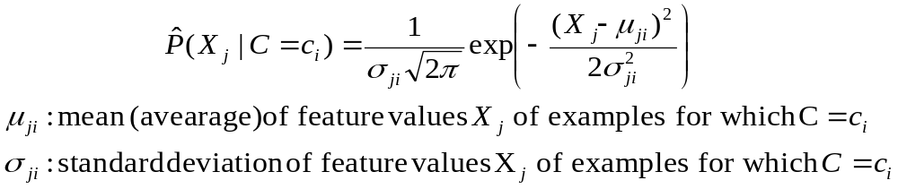



Naïve Bayes
Algorithm: Continuous-valued Features
  Numberless values for a feature
  Conditional probability often modeled with the normal distribution
  Learning Phase:
  Output: normal distributions and
  Test Phase: Given an unknown instance
    Instead of looking-up tables, calculate conditional probabilities with all the normal distributions achieved in the learning phrase
    Apply the MAP rule to make a decision

Slide 15
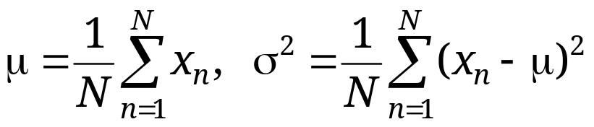
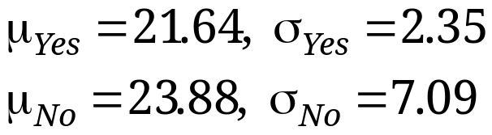
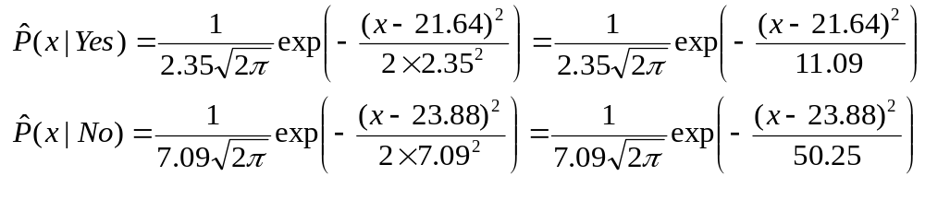
Naïve Bayes
Example: Continuous-valued Features
  Temperature is naturally of continuous value.
  Yes: 25.2, 19.3, 18.5, 21.7, 20.1, 24.3, 22.8, 23.1, 19.8
  No: 27.3, 30.1, 17.4, 29.5, 15.1
  Estimate mean and variance for each class
  Learning Phase: output two Gaussian models for P(temp|C)

Slide 16
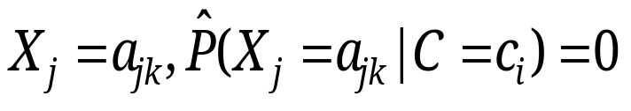
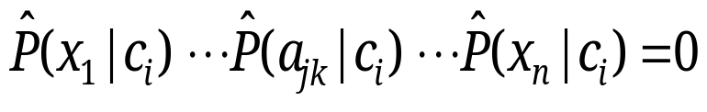
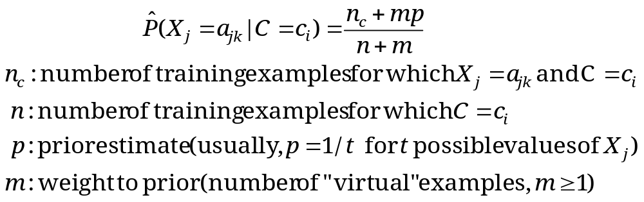
Relevant Issues
Violation of Independence Assumption
  For many real world tasks,
  Nevertheless, naïve Bayes works surprisingly well anyway!
Zero conditional probability Problem
  If no example contains the feature value
  In this circumstance, during test
  For a remedy, conditional probabilities re-estimated with

Slide 17
Summary
Naïve Bayes: the conditional independence assumption
  Training is very easy and fast; just requiring considering each attribute in each class separately
  Test is straightforward; just looking up tables or calculating conditional probabilities with estimated distributions
A popular generative model
  Performance competitive to most of state-of-the-art classifiers even in presence of violating independence assumption
  Many successful applications, e.g., spam mail filtering
  A good candidate of a base learner in ensemble learning
  Apart from classification, naïve Bayes can do more…

